Slide 1

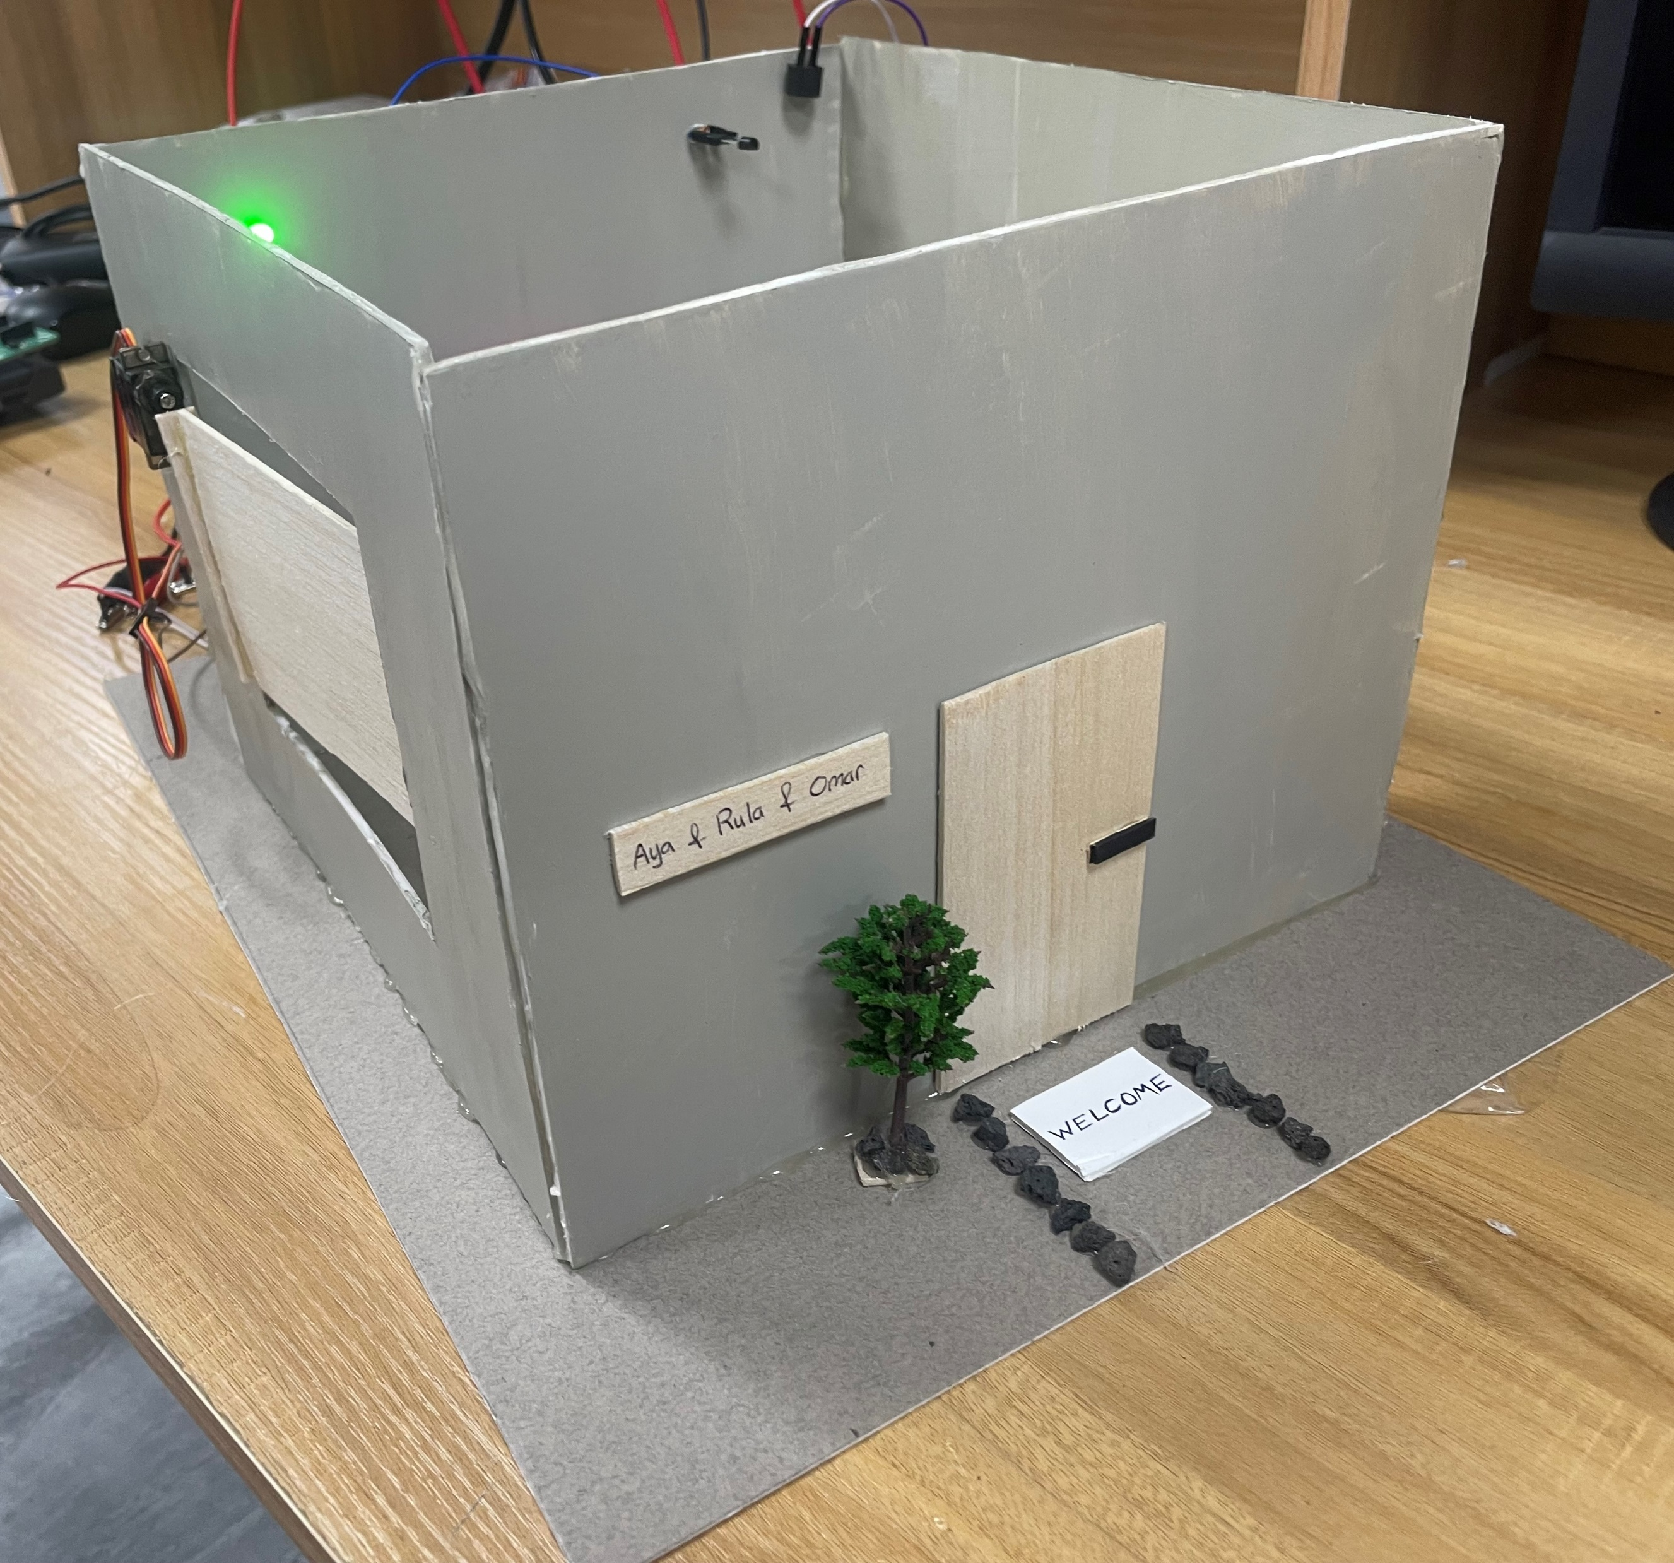
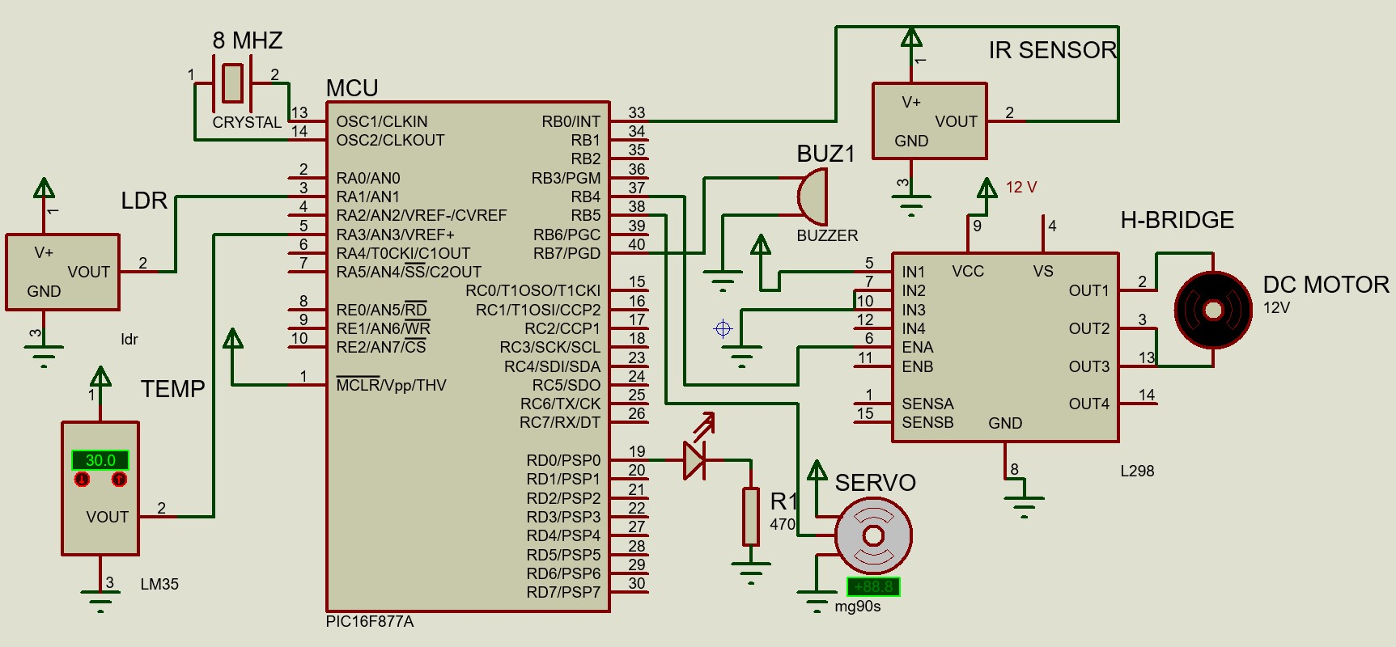
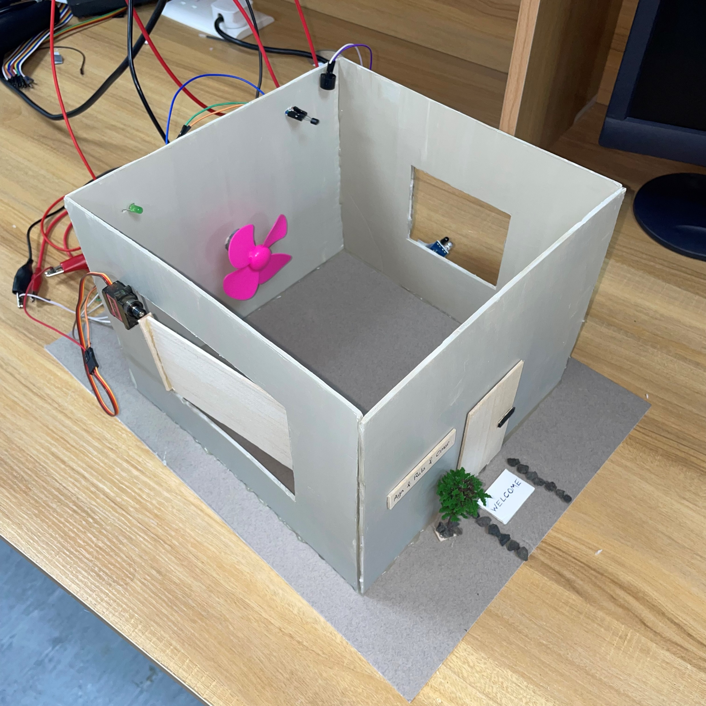
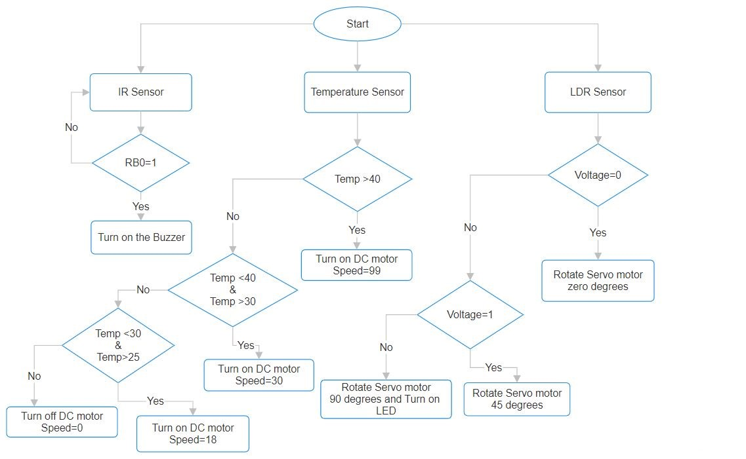
Smart Home System
Alabed, O. Al-Refai, R. Sufian
Supervisor: Dr. Belal Sababha
Embedded Systems Final Design Project, Fall 2023
King Abdullah II School of Engineering
Princess Sumaya University for Technology
Introduction
In this project, we designed a smart home model to automate and improve both home security and environmental conditions. The MCU interacts with several specialized interconnected devices. These devices include a servo motor responsible for managing the movable parts of a window shutter. The motor is guided by a light sensor, which activates the shutter to raise or lower based on the detected levels of light. Furthermore, the system includes a temperature sensor that operates a fan connected to a DC motor. This subsystem monitors and regulates the home's temperature to ensure optimal comfort. The system also showcases security features with an Infrared (IR) sensor positioned on the window. This sensor is designed to identify potential intrusions, triggering a buzzer to alert homeowners of potential security breaches.
Results
Two windows were incorporated, one designated for the shutter mechanism, and the other for the IR sensor. The shutter itself was crafted from lightweight Balsa wood, securely attached to the servo arm to ensure proper functionality. The buzzer and LED were affixed to the top of the structure, and a designated opening was created to accommodate the DC motor with the fan. The breadboard containing all the electrical connections was strategically positioned at the back of the model for accessibility and organization.
Figure 4: Overall Prototype Structure
Figure 5: Main Design Components
Design
The Microcontroller was integrated with components including the power supply, DC motor, IR sensor, buzzer, temperature sensor, LED, and Servo motor.
Figure 1: Schematic Design
Figure 2: Flowchart
Buzzer
LED
Temperature
DC Motor
IR Sensor
Servo Motor
Conclusion
In conclusion, our smart home project not only successfully operated as intended but also highlighted the transformative impact of integrating automation and intelligence. Beyond the technical achievements, this project emphasizes the broader significance of smart technologies in enhancing convenience, security, and energy efficiency, providing a compelling reason to embrace these advancements for a smarter and more harmonious lifestyle.

